Slide 1



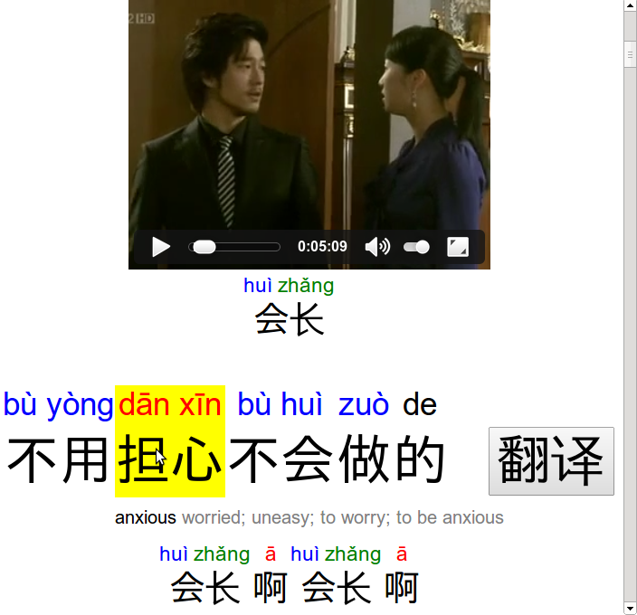
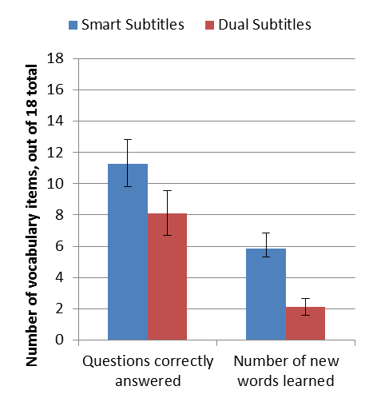
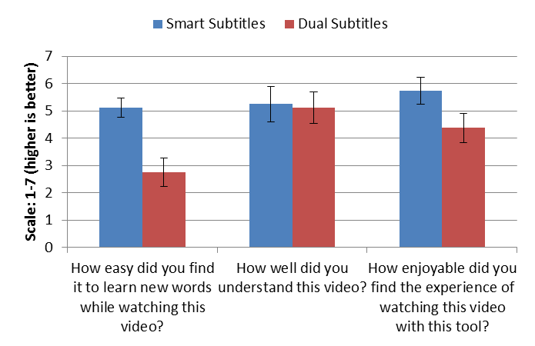
Foreign-language learners often watch subtitled videos
Subtitles are suboptimal
for language learning
But we need subtitles to understand the video
Anime, East-asian films in the US
English-language videos abroad
Hard to associate words in subtitles with the speech
Detract attention from the speech
Learners have difficulty with unsubtitled authentic videos, due to unknown vocabulary
Smart Subtitles for Language Learning
Geza Kovacs
MIT CSAIL
This work is supported by Quanta Computer as part of the T-Party Project. Thanks to Rob Miller and Chen-Hsiang Yu for advice and mentorship.
Contribution
An interactive transcript with features to help students studying Chinese learn vocabulary while watching videos
Automatically generated from Chinese captions on DVDs using dictionaries and machine translation
User Study
8 intermediate Chinese learners (1.5-2.5 years of study)
Each watched a pair of 5-minute clips; one with Smart Subtitles, one with Dual Chinese-English Subtitles
More vocab learned, with similar comprehension and enjoyability, when viewing with Smart Subtitles
Shows pinyin pronunciations
Review previous line of dialog
Future Work
Teaching sentence patterns and pronunciations through video
Enable passive usage by predicting words user doesn’t know
Define words by hovering
Translate
current line

